Slide 1

Visualizing World Economic Trends
UC Berkeley Extension Data Analytics
Liza Hartlaub, Marlon Schieber, Paul Song, Ray Zhang

Slide 2

United Nations Country Data
Summary of the data
Data Sets Used: United Nations Country Statistics, 20 international statistical sources compiled by the Statistics Division and the Population Division of the United Nations, from the year 2017.
country_profile_variables.csv [Columns:47 economic indicators such as: health, education, technology, CO2 emissions, etc.
country_profile_variables.csv [Rows:229 Countries]

Slide 3

Key Questions
Which regions of the world have the highest economic impact and highest growth forecast?
How does economic success affect unemployment and population growth within different economic sectors, such as the agriculture, industry, or service sectors?
Does economic success affect life expectancy, and if so, how effective is GDP investment into healthcare?
Is there a correlation between a country’s economic success and its technological and environmental indicators?

Slide 4



Python Libraries Utilized
import pandas as pd
import numpy as np
import matplotlib.pyplot as plt
import csv
import os

Slide 5
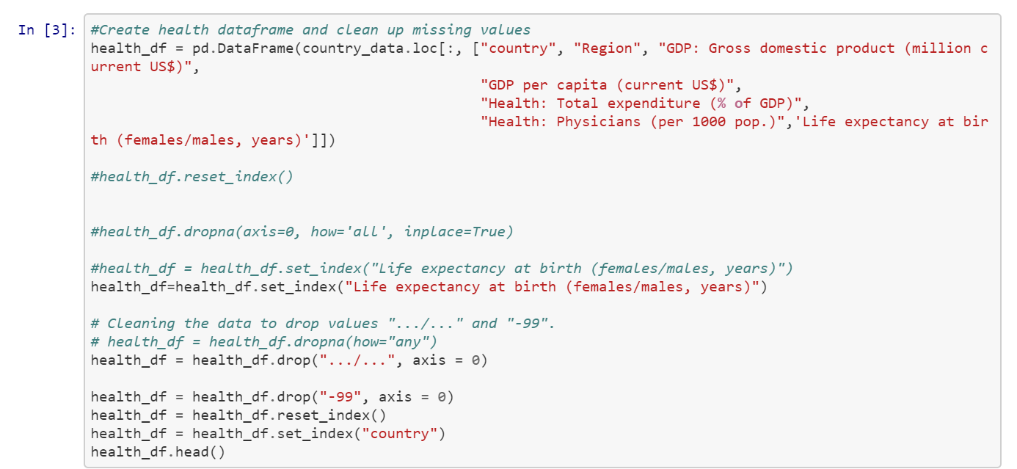
Data Cleaning Code Snip

Slide 6

Global economic fundamentals
Which regions of the world have the highest economic impact?
Which regions have the highest growth forecast?
How does economic size affect the unemployment rate?
How do different industries of an economy affect urban population growth?

Slide 7
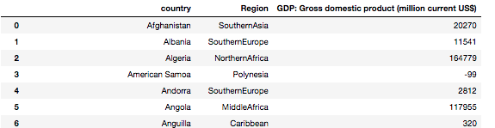
Cleaning data
# change values to numeric
country_region_gdp_df.loc[:,'GDP: Gross domestic product (million current US$)'] =
pd.to_numeric(country_region_gdp_df.loc[:,'GDP: Gross domestic product (million current US$)'], downcast='integer')
# check data types
country_region_gdp_df['GDP: Gross domestic product (million current US$)'].dtypes
#remove the -99 values
country_region_gdp_df = country_region_gdp_df[country_region_gdp_df['GDP: Gross domestic product (million current US$)'] != -99]

Slide 8
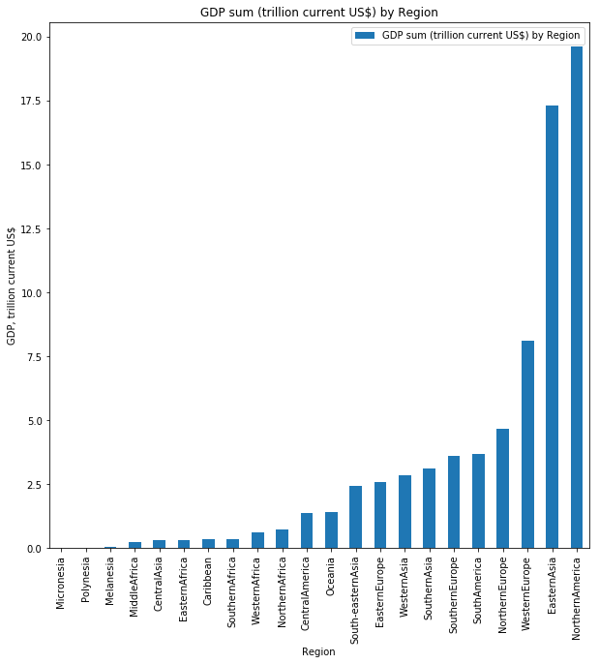
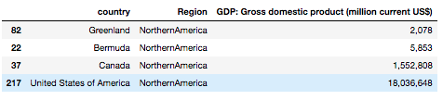
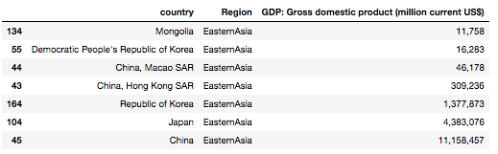
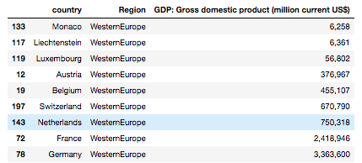
GDP total by Region

Slide 9
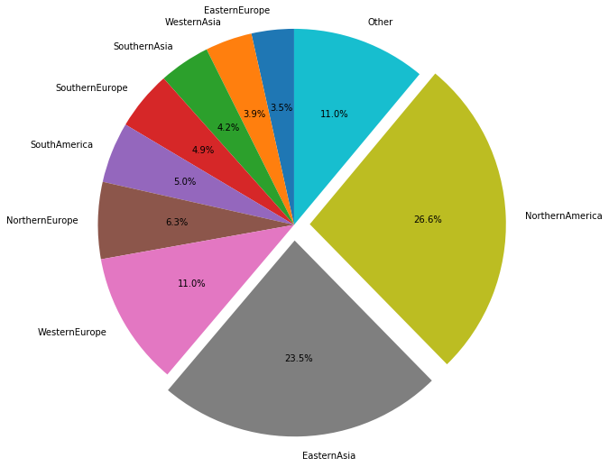
Percentage of Global GDP by Region
50% of global GDP output, is found in two regions alone

Slide 10
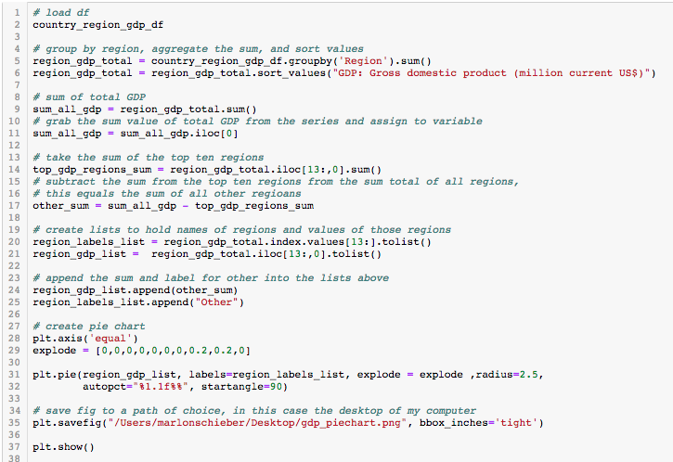
Code for Pie Chart

Slide 11
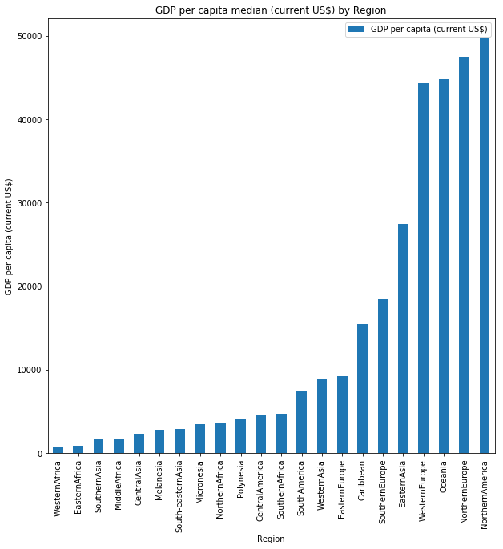
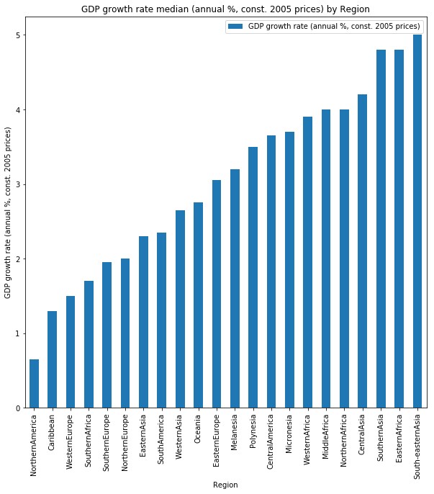
Northern America, Northern Europe, Oceania and Western Europe, have the highest median GDP per capita
Asian and African regions have the highest median GDP growth rates

Slide 12
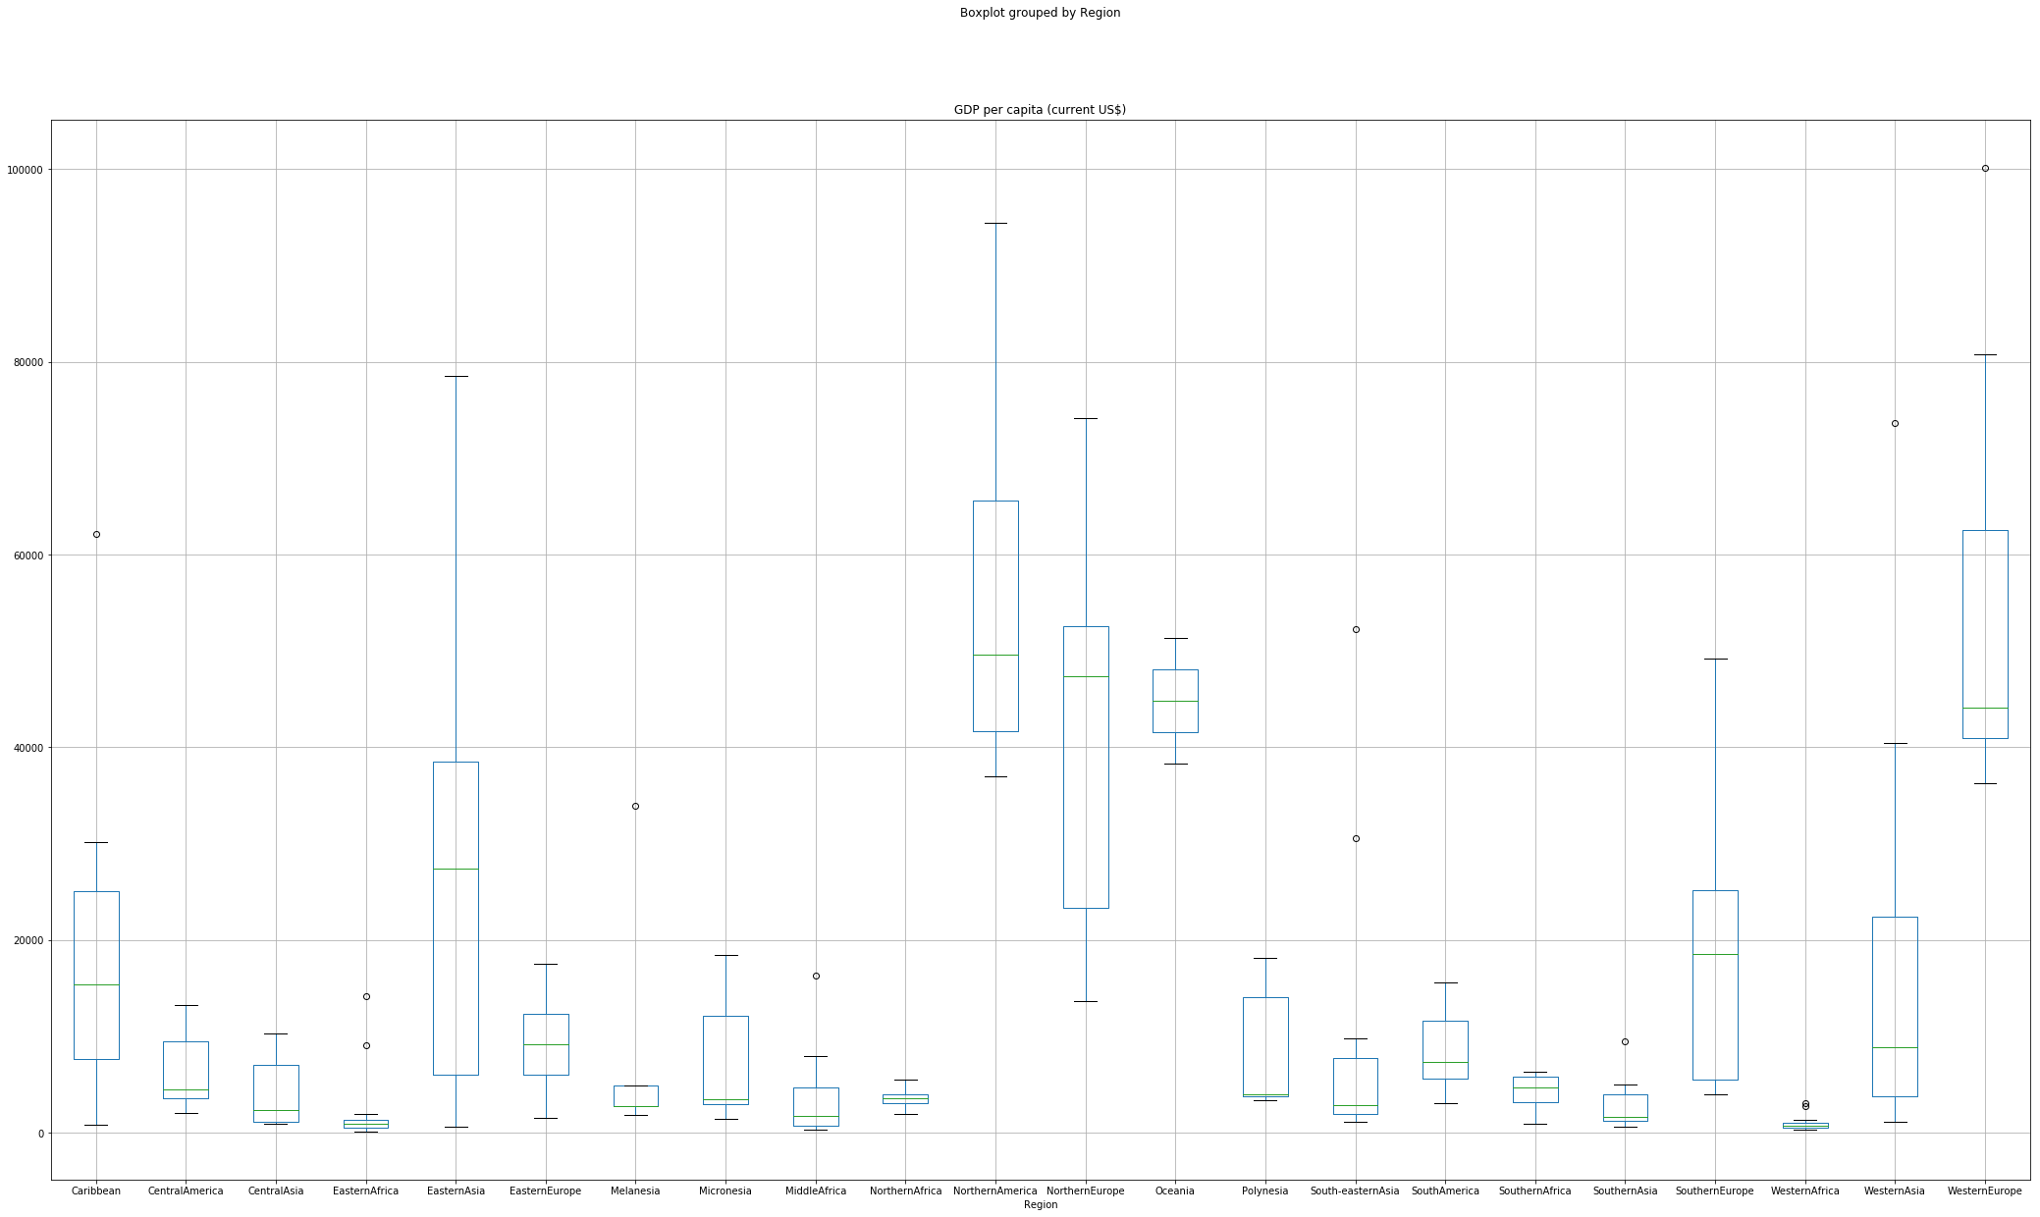
GDP per capita boxplot of regions

Slide 13
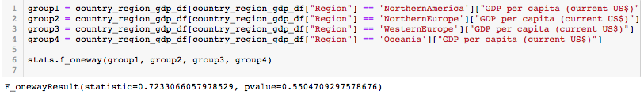
With the exception of Oceania, regions that have the highest median GDP also have the widest distribution in GDP values
Based on the p value of the top GDP/capita regions, we are unable to reject the null hypothesis, and therefore the differences between the top regions may not be statistically significant

Slide 14
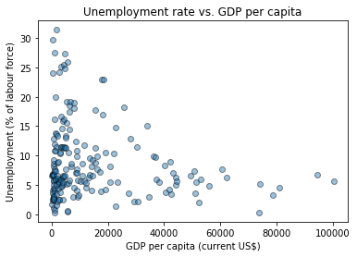
How does GDP per capita affect the Unemployment rate?
Unemployment rate is less than 10%, when GDP per capita is 40,000 US$ or more
However regions with lower GDP per capita, may still also have a low unemployment rate

Slide 15
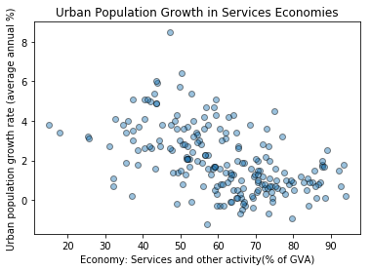
Higher services based economies, have lower urban population growth

Slide 16
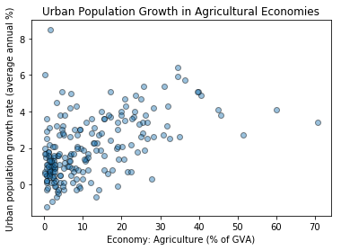
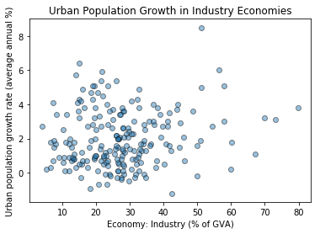
More industrial and agricultural based economies do not necessarily have higher urban growth rates

Slide 17

Life Expectancy
Is there a correlation between the percentage of a country’s GDP spent on healthcare and life expectancy for men and women?
It appears that for the countries that spend approximately 4% to 8% of their GDP on healthcare most men and women lived to be about 75 to 80 years old. However, the countries that spent 10% to 12% saw the greatest life expectancy at 85 years. Only a couple countries such as the United States spend about 16% of their GDP on healthcare and only gain a marginal improvement in life expectancy at about 83 years old.
Data Source: https://www.kaggle.com/sudalairajkumar/undata-country-profiles/home

Slide 18
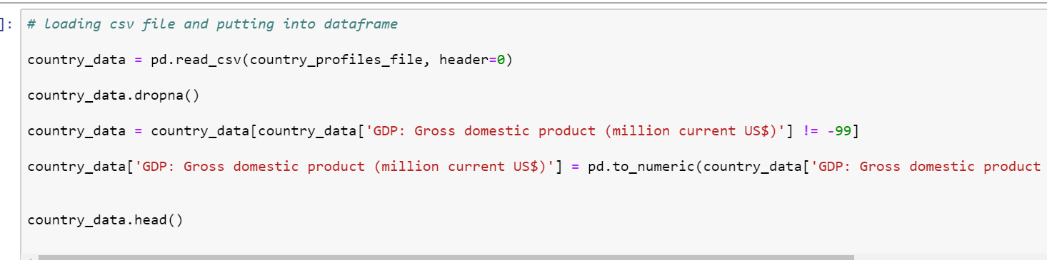
Data Cleaning

Slide 19
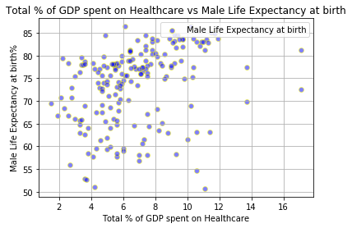

Slide 20
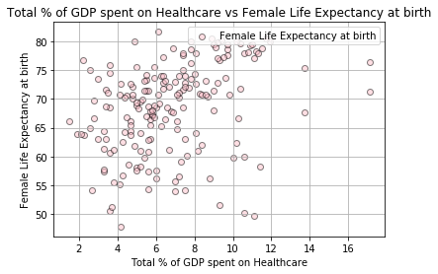

Slide 21

Modernization
What is the correlation between a country’s economic output and level of modernization?
Hypothesis: there is a correlation between a country’s GDP and its modernization – and as a country’s economy develops, its level of urbanization and access to technology increases.

Slide 22
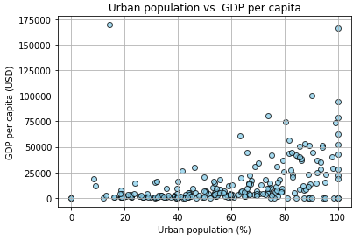
Urbanization
As the percentage of the urban population increases, so does the GDP per capita.
However, there are still countries with large urban populations that nonetheless have low GDP per capita.

Slide 23
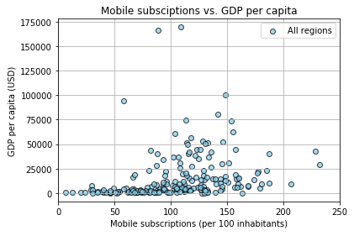
Mobile Phone Usage
Similarly, as mobile phone usage increases, so does a country’s GDP per capita.

Slide 24
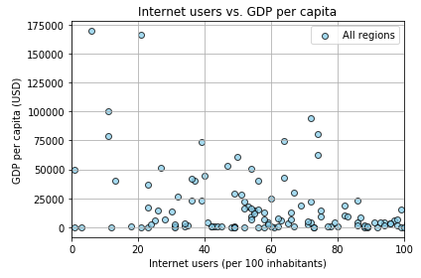
Internet Usage
On the other hand, there does not seem to be a correlation between Internet usage and GDP per capita.
And there are some countries that have exceptionally high GDP per capita despite lower than average Internet usage.

Slide 25
Environmental Impact of World Economies
Which regions in the world have the most Carbon efficient economies?

Slide 26
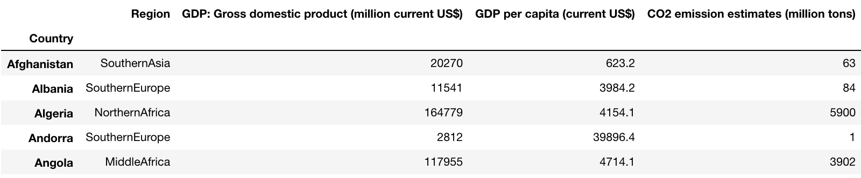
Cleaning My Data

Slide 27
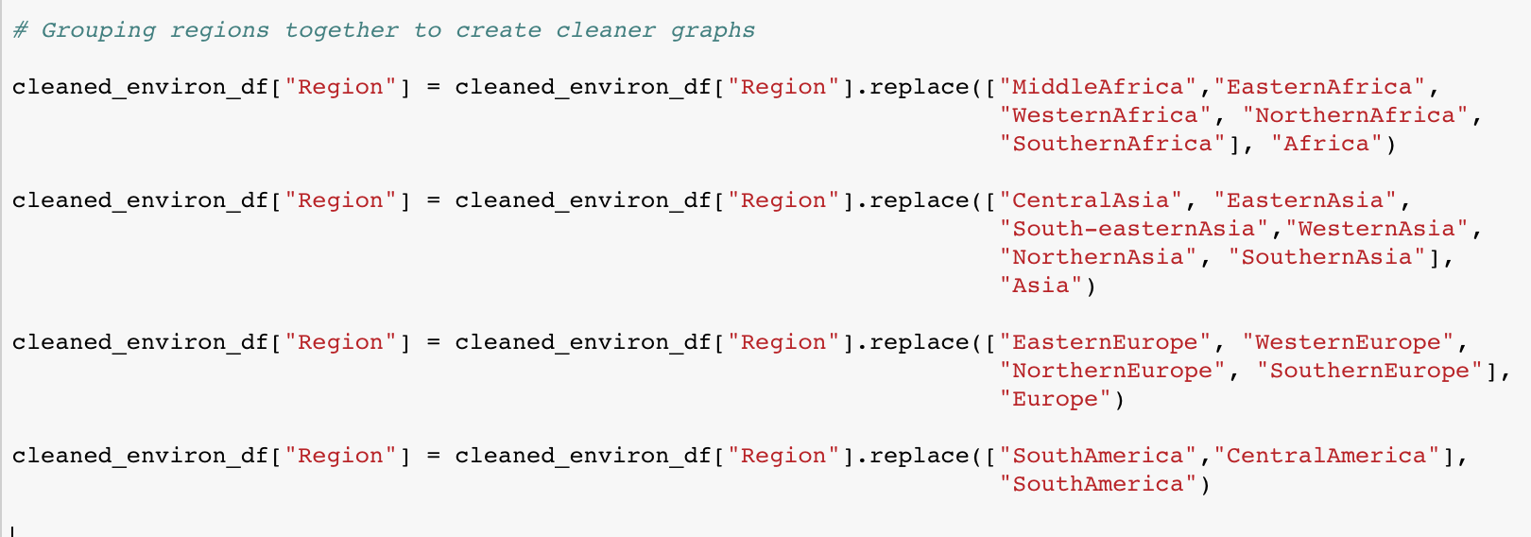
Cleaning My Data

Slide 28
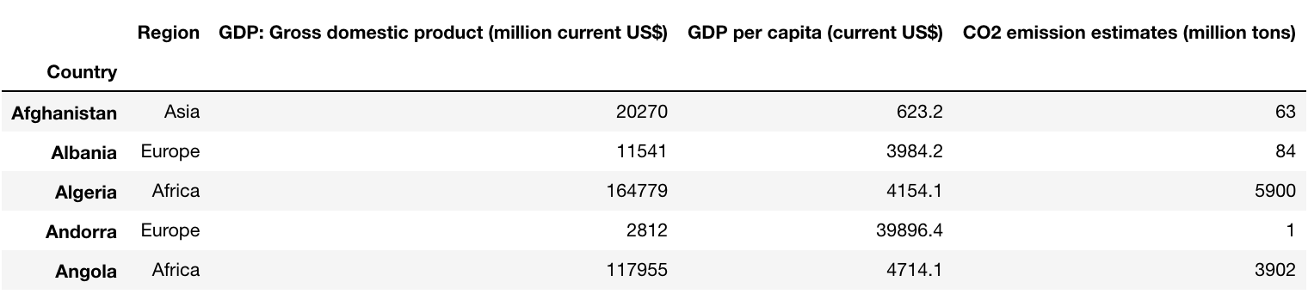
Cleaning My Data

Slide 29
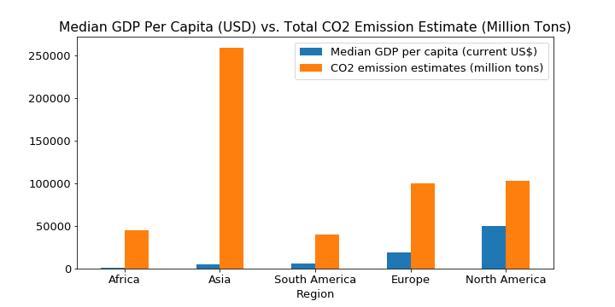
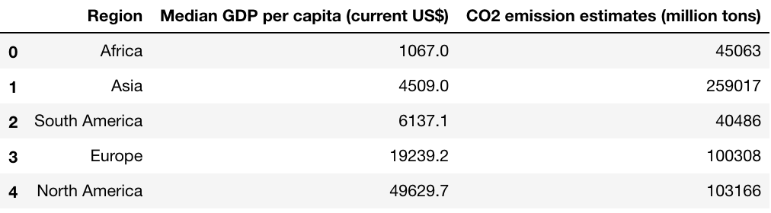
CO₂ Levels Relative to GDP by Region
The North American region has the highest median GDP per capita at $49,629.70 while Asia has the highest estimated CO₂ emissions at 259,017 million tons.
What does this tell us about how Carbon efficient a region is though?

Slide 30
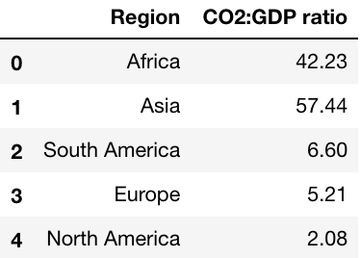
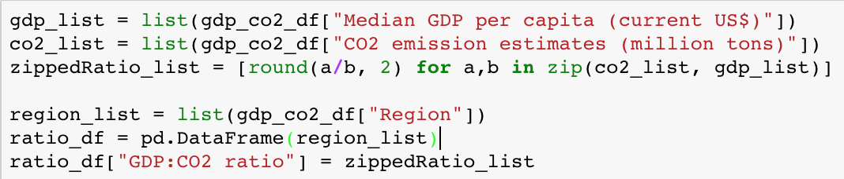
Utilizing List Comprehensions

Slide 31
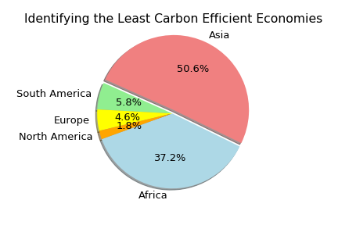
The Most Carbon Efficient Economies
Conclusion:
The North American region has the lowest CO2:GDP ratio, indicating that it has the most carbon efficient economy.
Asia has the least carbon efficient economy due to it’s high emissions.
Africa was second most inefficient due to it’s low median GDP per capita.

Slide 32
Appendix, code examples

Slide 33
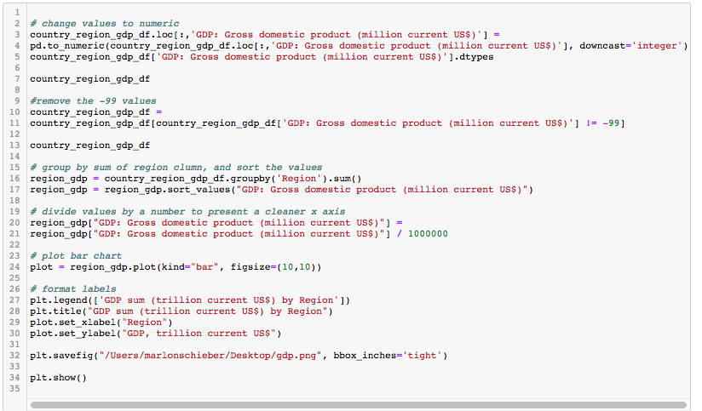
Total GDP, bar chart code

Slide 34
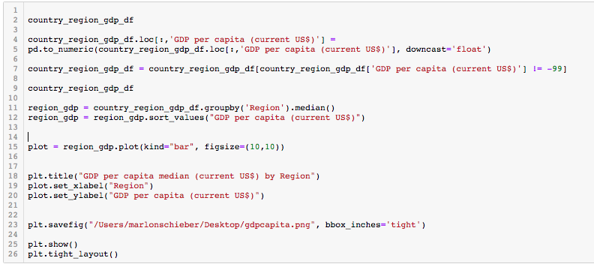
GDP per capita median, bar chart

